Slide 1
Topic 7 – Feature Engineering and Variable Selection
Data Science for Business
Prof: Chris Volinsky
NYU Stern: Fall 2024

Slide 2
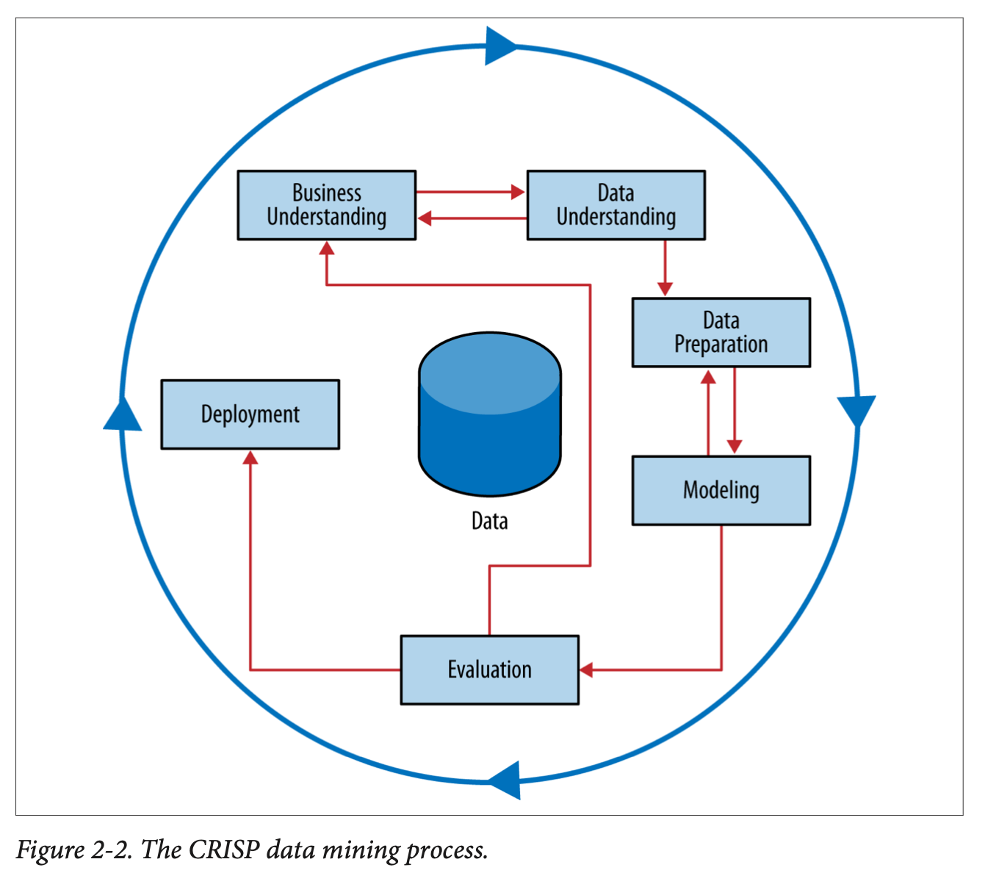
Feature Preparation
The data you originally get access to is almost never the data you want to use in your modelling.
Depending on the situation you may need to add, or remove attributes before modelling
Adding attributes
Feature construction
Feature engineering
Removing Attributes
Dimension Reduction
Variable Selection

Slide 3
Adding Attributes

Slide 4
Feature Engineering
Sometimes features need to get created from multiple relational tables.
Name | Gender | Age | Income | Response (Target)
Alicent | F | 34 | Hi | 1
Bala | M | 21 | Mid | 0
Chantal | F | 29 | Lo | 1
…. | … | … | … | …
Task:
Predict whether a customer will
respond to a special offer, based on previous purchases
Given:
Customer attributes/demographics
Additional table with previous orders
Name | PurchaseDt | Type | Price | Coupon?
Alicent | 2023-10-02 | Digital | $9.99 | Yes
Alicent | 2023-09-11 | Digital | $19.99 | No
Alicent | 2023-08-11 | Book | $24.99 | No
Bala | 2023-11-01 | DVD | $24.99 | No
Bala | 2022-12-12 | Digital | $19.99 | No
Bala | 2024-01-02 | Book | $34.99 | Yes
Chantal | 2023-11-01 | DVD | $4.99 | Yes
Chantal | 2023-11-01 | Book | $4.99 | Yes
… | … | … |  | …
Notes:
Get class to do this? Ask them to create features. Purchases are over the last year of purchases
Training set is ABC from a pilot study…going to apply it to other people

Slide 5
Feature Engineering
Name | Gender | Age | Income | Resp
Alicent | F | 34 | Hi | 1
Bala | M | 21 | Mid | 0
Chantal | F | 29 | Lo | 1
… | … | … | … | …
Name | PurchaseDt | Type | Price | Coupon?
Alicent | 2023-10-02 | Digital | $9.99 | Yes
Alicent | 2023-09-11 | Digital | $19.99 | No
Alicent | 2023-08-11 | Book | $24.99 | No
Bala | 2023-11-01 | DVD | $24.99 | No
Bala | 2022-12-12 | Digital | $19.99 | No
Bala | 2024-01-02 | Book | $34.99 | Yes
Chantal | 2023-11-01 | DVD | $4.99 | Yes
Chantal | 2023-11-01 | Book | $4.99 | Yes
… | … | … |  | …
How do we turn this into a supervised learning scenario?
Name | X1 | X2 | X3 | X4 | X5 | Target
Alicent |  |  |  |  |  | 1
Bala |  |  |  |  |  | 0
Chantal |  |  |  |  |  | 1
Notes:
There are two ways to do this! Append demos to all purchases? Or summarize all purchases in feature engineering…follwoign slides show

Slide 6
Feature Engineering
Feature Engineering: what attributes can we create from the original data that get at the behavior we want and allow us to model with it?
Name | PurchaseDt | Type | Price | Coupon?
Alicent | 2023-10-02 | Digital | $9.99 | Yes
Alicent | 2023-09-11 | Digital | $19.99 | No
Alicent | 2023-08-11 | Book | $24.99 | No
Bala | 2023-11-01 | DVD | $24.99 | No
Bala | 2022-12-12 | Digital | $19.99 | No
Bala | 2024-01-02 | Book | $34.99 | Yes
Chantal | 2023-11-01 | DVD | $4.99 | Yes
Chantal | 2023-11-01 | Book | $4.99 | Yes
… | … | … |  | …
Name | Gend | Age | Inc | Sum Sales | Resp
Alicent | F | 34 | Hi | $54.97 | 1
Bala | M | 21 | Mid | $79.97 | 0
Chantal | F | 29 | Lo | $9.98 | 1
… | … | … | … |  | …
Notes:
What other attributes can we create? Number of sales, total sales, avg. sales, type of purchase, recency, max sale..

Slide 7
Feature Engineering
Naïve approach, just do a join:
Name |  |  |  | PurchaseDt | Type | Coupon? | Response
Alicent | F | 34 | Hi | 2023-10-02 | Digital | Yes | 1
Alicent | F | 34 | Hi | 2023-09-11 | Digital | No | 1
Alicent | F | 34 | Hi | 2023-08-11 | Book | No | 1
Bala | M | 21 | Mid | 2023-11-01 | DVD | No | 0
Bala | M | 21 | Mid | 2022-12-12 | Digital | No | 0
Bala | M | 21 | Mid | 2024-01-02 | Book | Yes | 1
Chantal | F | 29 | Lo | 2023-11-01 | DVD | Yes | 1
Chantal | F | 29 | Lo | 2023-11-01 | Book | Yes | 1
… | … | … | … | … | … | …
This could work, what might be the issues here?
Notes:
Now you are modelling PURCHASES instead of users, someone with many transactions is much more represented in the data.
Changes baseline. Also much more data
And you don’t get the advantage of adding more features…

Slide 8
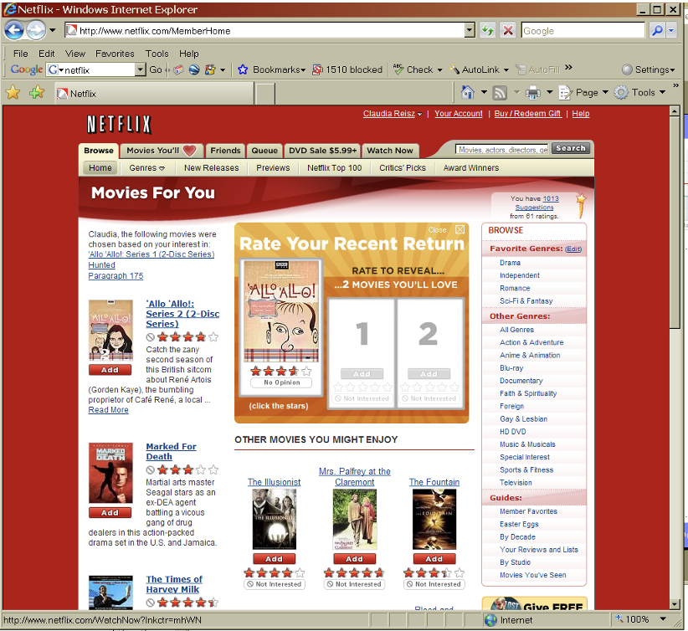
Netflix Prize Example
Notes:
This is what Netflix looked like in the early 2000s….

Slide 9
Netflix Prize Data
480k unique users
date | score | movie | user
2002-01-03 | 1 | 21 | 1
2002-04-04 | 5 | 213 | 1
2002-05-05 | 4 | 345 | 2
2002-05-05 | 4 | 123 | 2
2003-05-03 | 3 | 768 | 2
2003-10-10 | 5 | 76 | 3
2004-10-11 | 4 | 45 | 4
2004-10-11 | 1 | 568 | 5
2004-10-11 | 2 | 342 | 5
2004-12-12 | 2 | 234 | 5
2005-01-02 | 5 | 76 | 6
2005-01-31 | 4 | 56 | 6
… | … | … | ….
6 years of data
102M rows
Also:
Movie | Title
1 | Dinosaur Planet
2 | Midnight Run
… | …
17,700 unique movies
Notes:
What are the features? What is the target?
Build a model for each movie.
Want to predict if someone will like Jurassic Park
Need a matrix – training data of all the people who watched Jurassic Park
Target is rating of JP
What are the features?
What is the average number of movies rated per user?
What is the average number of users that rate a movie?
Want to create features for the users, how can we do that? Create 10 for users and 10 for movies…
Max rating user”. 17659 (is that real?) average is just over 200…
Max number of ratings movie? 240k – Miss Congeniality.
Number of movies rated
Average of movies rated
Max score
Min score
Average score
SD score
How did they rate similar movies to Jurassic park how did they rate movies with same director (if any)
% of ratings that are 5
Day span of ratings
Max ratings on a single day
Most recent rating (how many days ago)
DATE ISNT USEFUL!
Movies
How many people rated it?
What is the span of time?
Genre
Sub-genre
director

Slide 10
Feature Engineering
Some things you may want to do to features before modelling:
Convert Categorical Variable to dummies
Covert Numeric Variable to categorical
define highest 10% or H/M/L categories
Binning of target or attribute to account for long tail
Convert strings to date variables
Extract year/month/hour from date as separate features
Calculate useful features from dates (tenure, duration, last seen)
Combine columns
Mean, max, min, or total might be more relevant than individuals
Create polynomial versions
Get Creative!!

Slide 11
Feature engineering: one more example
Another example: network data – viral marketing
All we have is who communicated with who, and how much
Network Attribute | Description
Degree | Number of people directly communicate with
Hop-2 Degree | Number of people 2 hops away
Connectedness | How dense is communication network
Hop-1 targets | Existing iphone users in hop-1 network
Hop-2 targets | Existing iphone users in hop-2 network
Hop-1 Comm | Communication minutes (or texts) to Hop-1 targets
Hop-2 Comm
Network overlap with Hop-2 targets | Measure of network overlap
Insight – top-2 buddies were more predictive than anything else

Slide 12
Feature Selection

Slide 13
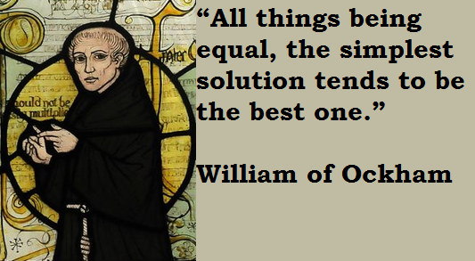
Removing Unimportant Attributes
It is helpful to remove unimportant features from your modelling.
Sometimes it is obvious (like a serial number), sometimes it is an iterative step after an initial modelling exercise
Why?
Model Accuracy
Overfitting
Efficiency – for fitting and use modes
Interpretability
Occam’s Razor
In some examples you might be handed (or can engineer) thousands, or even millions of attributes!

Slide 14
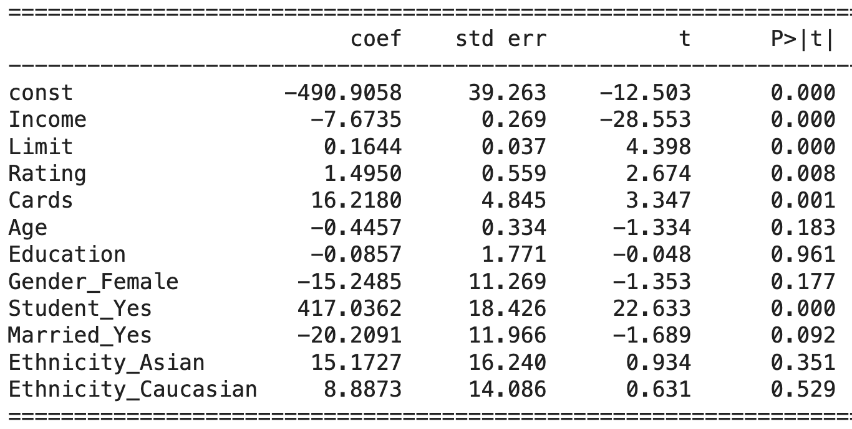
Iterative Feature Selection by Subtraction
Steps:
Fit a model with all features
Identify feature importance (or significance)
Remove “noise features”
Re-fit model and assess value
Credit Data
Backward elimination :
Stepwise, at each step
eliminate one variable at a time
Re-fit model and assess RMSE/R²
Stop when model performance degrades
Iterative removal is a bit more “careful” than block removal
Notes:
Removing

Slide 15
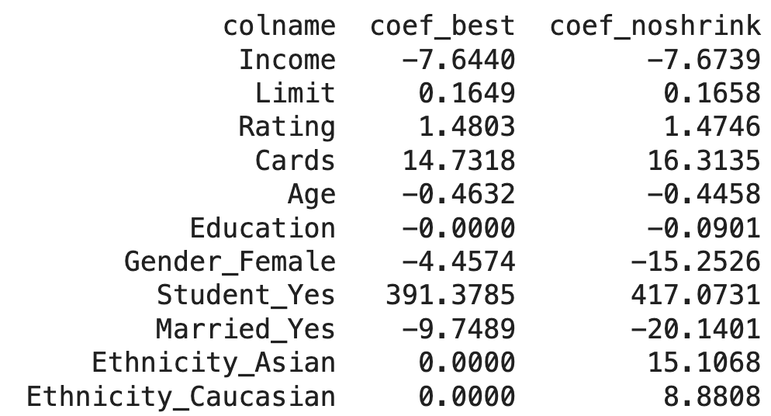
Recall: Lasso (L1) Regression
Lasso (L1 Regularized) Regression is another way to reduce the number of features
Use CV to find the best value of lambda
Fit data with optimal lambda
Remove features with coefficient = 0

Slide 16

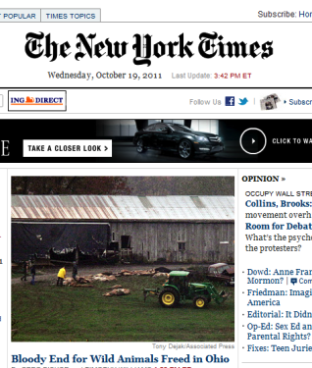
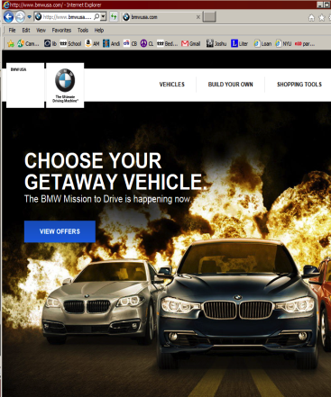



Example: Online advertising
Dstillery:
Ad targeting company based in NYC
Example courtesy Claudia Perlich
300 Million (US) consumer
Interacting with
brand sites
Using Digital Devices
Measurement
Conversion
If we win an auction
we serve ad of brand
100 ms to bid
Work
with Brand
Ad Exchange
100 Billion
bid requests per day

Slide 17
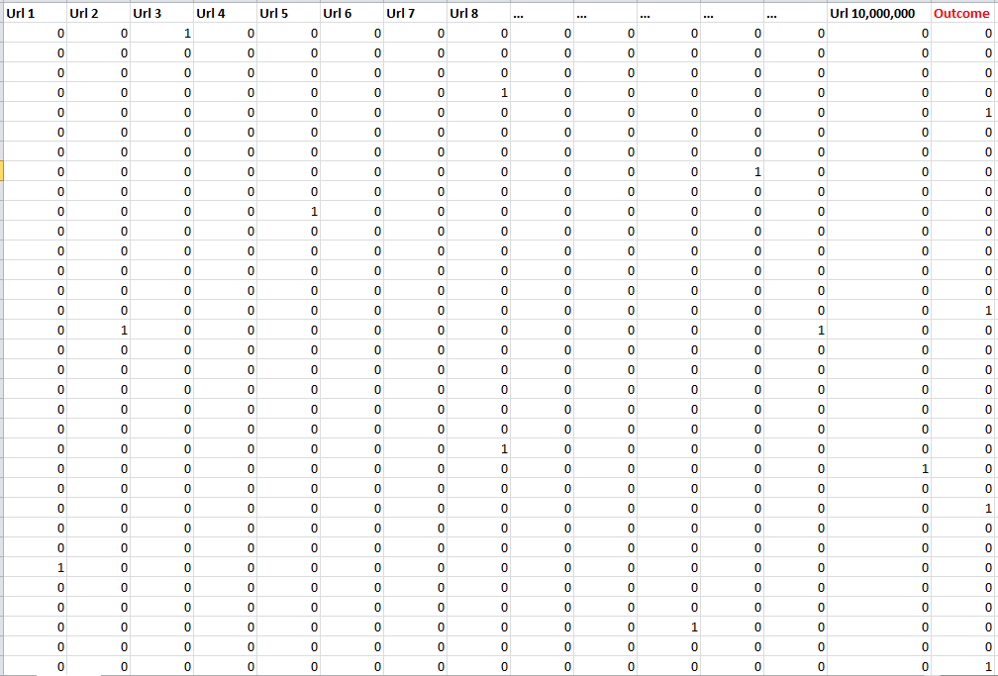
A real example….
10 Million Columns
1-50K Positives
Notes:
Maybe very few (cruise) maybe zero! (cold start)
problem is lack of positive examples. Base rate is really low! maybe very few people who purchse, and even less who purchased because the boght an ad!!
Or maybe we havent shown the ad yet!!
Proxy : don’t worry about click, or even purchase, just look at those who shopped there.
we get two orders of magnitued more of data, can get more signal.
lets just try and define peopel who are interested in Pottery Barn...without purchase.

Slide 18



Dstillery Data: 100 Billion events per day across devices
Web
App
amazon.com
4/11/16
Zip 4
10023-4592
04/15/16
Zip 4
10023-6924
04/20/16
Zip 4
10016-2324
03/10/16
03/14/16
50.240.135.41
buzzfeed.com
3/20/16
166. 216.165.92
nytimes.com
2/15/16
Desktop
207.246.152.60
Mlb.com
3/15/16
com.mlb.atbat
04/20/16
108.49.133.218
208.76.113.13
IDFA
31AB-26FC-94AE-756B
com.rovio.angry
02/26/16
Etrade.com
4/25/16
azure.microsoft.com
4/10/16
38.104.253.134
com.myfitnesspal.android 3/25/16 4/18/16
Phone/Tablet
Phone/Tablet

Slide 19
Real world issues
Cold Start – how to model cases where we don’t have data yet to train on?
Rare events – what do we do if there are very few positive examples?
How do we think about reducing attribute space?
Do we need to engineer features?

Slide 20
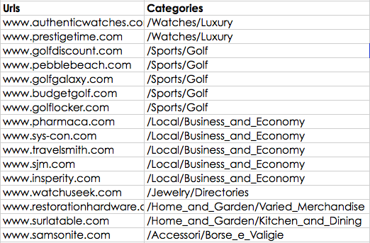
Feature Reduction - Clustering
Dstillery purchased data that allowed them to categorize all URLs into topics:
www.baseball-reference.com => Sports/Baseball/Major_League/Statistics
Often of poor quality or outdated, but good enough .. Maybe?
Could reduce 10M columns to 1k columns
Notes:
But that is only for raw counts, also intensity, recency, proportion.

Slide 21


Dimension Reduction – Principal Components
Principal Components Analysis (PCA)
One other possibility for dimension reduction when you have a lot of features
Mathematically:
A projection of numerical values from a high dimensional space into a smaller dimensional space while retaining the maximal amount of information in the data
ISL: Ch 6.3.1

Slide 22
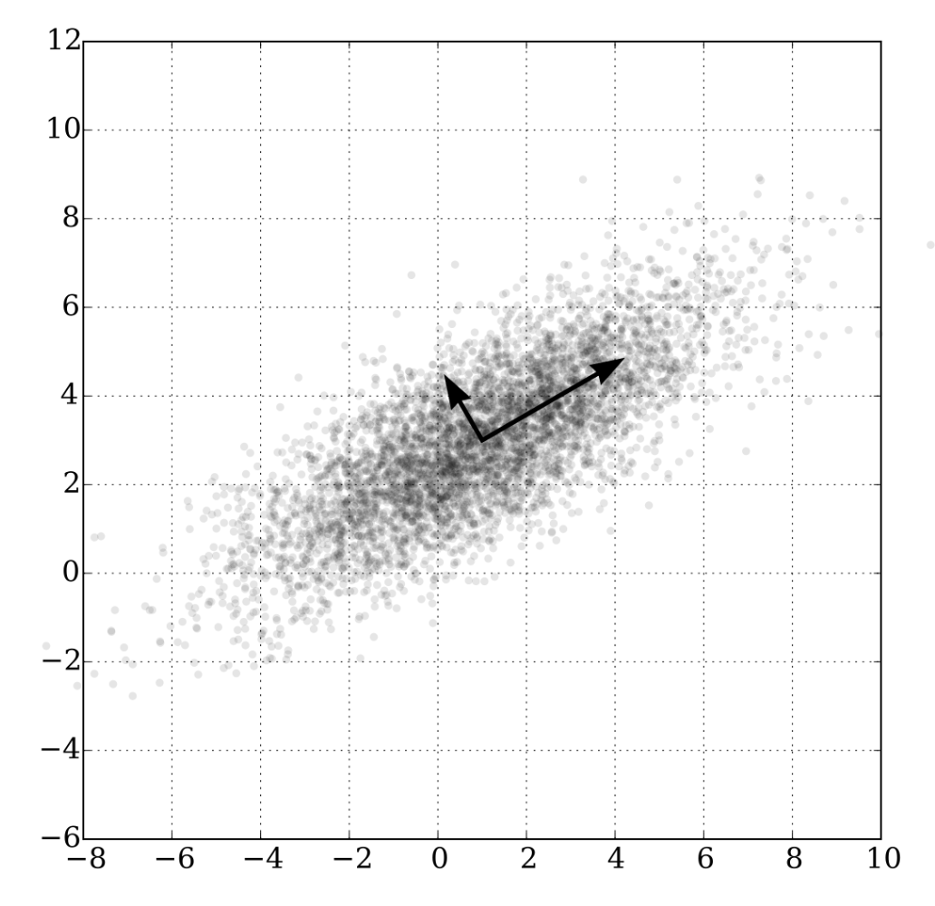
Principal Components Analysis
PCA is a method to create a new set of features from the original ones
There are many less of them
They are a linear combinations of the original features
And, they capture the `maximum amount' of variance in the observed data.
For features that have multicollinearity, a linear combination can provide most of the information while reducing the data set
Notes:
the more correlated it is, the less information there is...

Slide 23
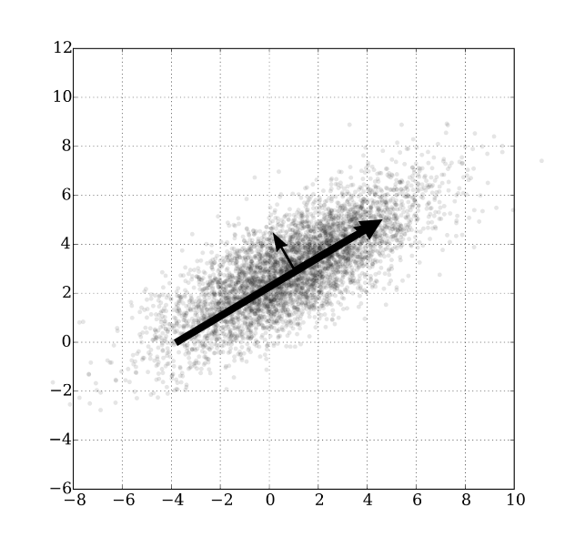
Principal Components
ISL: Ch 6.3.1
Expand this to many dimensions
You can take a high-dim data set and reduce it to something much smaller and not lose much information
Each PCA feature is a linear combination of ALL of the original features
Beware : variables should be standardized (mean=0, sd=1) for PCA
Principal Components Regression
Take original data and reduce to the top principal components
How many? Can use Cross-validation to figure it out!
Fit regression on PC instead of original data

Slide 24
PCA – pros and cons
PCA is great for:
Speeding up the training of a model (by reducing it) without significantly decreasing the predictive ability.
Reducing multicollinearity, and thus potentially improving the computational stability and time required.
Reducing dimensionality in very high dimensional settings.
When you are predicting multiple targets and don’t want to remove any features
PCA is not so good in certain situations because:
Interpretation of coefficients in PCA is lost. Each PCA feature is a linear combination of ALL of the original features
Requirement to normalize original features further reduces interpretability.
High variance does not indicate high importance. Sometimes PCA does not improve performance of the model

Slide 25
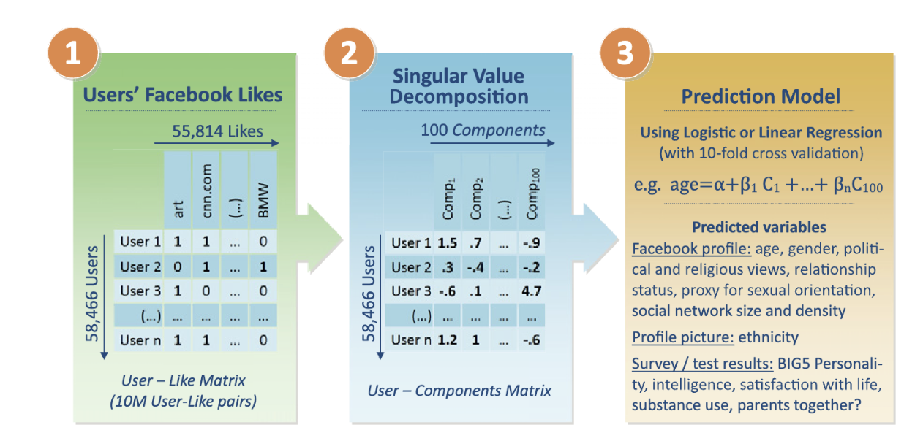
PCA in action
PNAS Facebook Paper – read for next class
Note : Singular Value Decomposition = Principal Components

Slide 26
Ad Clicks
What about Dstillery?
They employed many of these techniques at the same time
Clustering
Principal components
Identies “latent” dimensions, or features of the data space
Removal of useless variables
A model with about 4k attributes could perform as well or better than one with 10M
Ran much faster!
Easier to interpret
Learned a lot along the way!

Slide 27
Summary
The data you get shouldn’t be the data you use!
Successful analyses include hard thought about creation or reduction in the data attributes
Creation
Attribute creation through aggregation
Feature engineering through combination
Reduction
Removal via backward elimination
Mathematical methods like PCA

